Slide 1

Data Analysis
(Developed Tools)

Slide 2
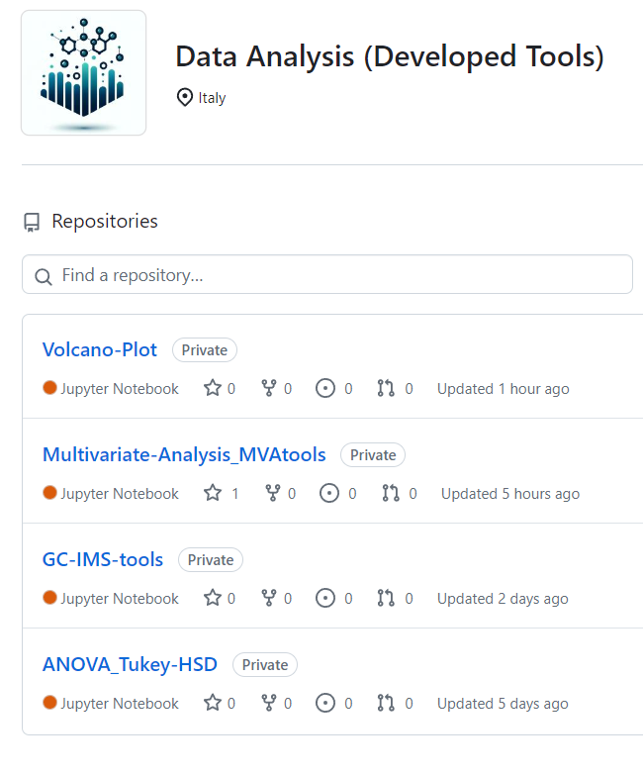
Data Analysis
(Developed Tools)

Slide 3
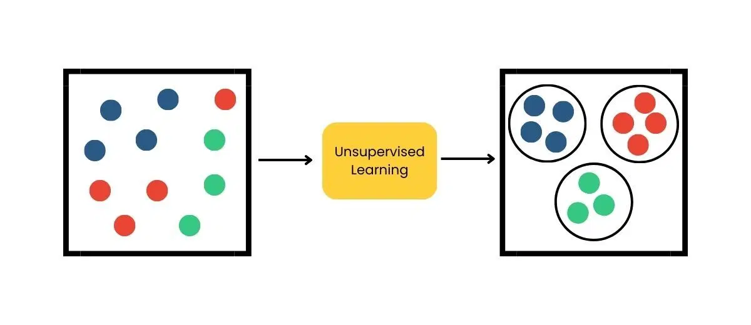
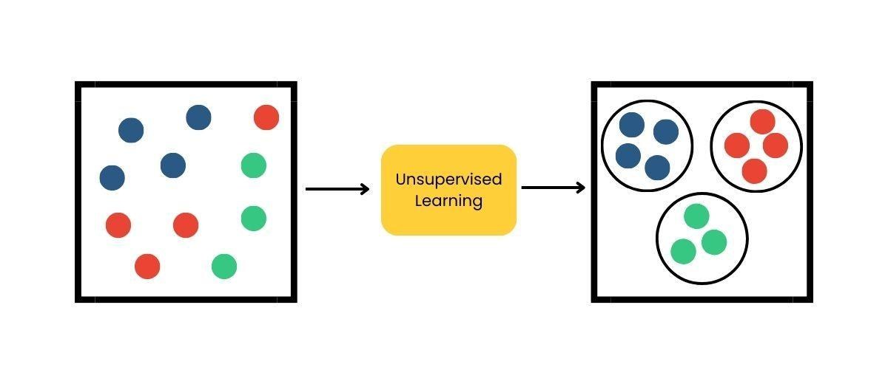



MVAtools
MULTIVARIATE ANALYSIS TOOLS
(home-made and free)
PYTHON SCRIPTS
FROM .CSV TO MULTIVARIATE ANALYSIS
UNSUPERVISED SUPERVISED VALIDATION
May 2024 - Developed by F. Spataro (francesco.spataro@unipr.it)

Slide 4
CONTENT
UNSUPERVISED
SUPERVISED
VALIDATION
PCA and HCA
PCA Score Plot
PCA Loadings Plot
HCA Dendrogram (based on PCA)
Explained and Cumulative Variance
Outliers Plot
PLS-DA (with VIP selection)
Explained and Cumulative Variance
Score Plot
HCA (based on PLS-DA)
Loadings Plot
Coefficients Plot
VIP selection and VIP-filtered file export
PLS-Regression
Observed vs Predicted Plot
R²
Predictive-VIPs
(VIP selection and VIP-filtered file export)
Internal
K-Fold Cross Validation
External (Random or Manual Splitting)
Training/test set plot
Confusion matrix
May 2024 - Developed by F. Spataro (francesco.spataro@unipr.it)

Slide 5

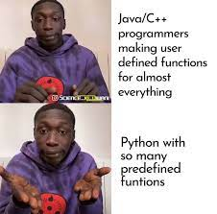
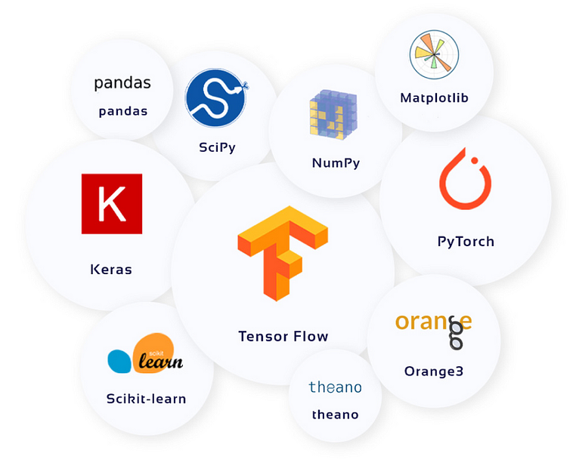

WHY ON PYTHON?
*Open-source libraries
**
The art of copying
*Open-source libraries: a collection of modules and functions that allows you to add functionality to code without writing from 0.
**Chat-GPT: even the free version is very good at explaining Python code, as well as writing/correcting it
directly
May 2024 - Developed by F. Spataro (francesco.spataro@unipr.it)

Slide 6




WHY ON PYTHON?
Often the best choice for beginners:
Simple syntax: dynamic typing, intuitive syntax (key-words)
Ease of learning and use
Flexibility and versatility: wide availability of specialized libraries and frameworks (very active community).
NumPy: Essential for scientific computing, it supports large arrays and matrices, and provides advanced mathematical functions.
Pandas: Crucial for data analysis and manipulation, it offers flexible data structures designed to work easily with tabular data.
Matplotlib: A leading library for creating plots, it allows for the generation of a wide range of static, animated, and interactive figures in Python.
Scikit-learn: The go-to library for machine learning, providing simple and efficient tools for data analysis and predictive modeling.
The core for data analysis
May 2024 - Developed by F. Spataro (francesco.spataro@unipr.it)

Slide 7



PYTHON
FERRERO computer requires the use of Anaconda (or similar) to launch Python:
ANACONDA: Python Distribution
The use of "interactive environments“, called notebooks, is highly recommended (instead of using the Windows command prompt)
JUPYTER
NOTEBOOK
(Multivariate analysis tools developed here)
VISUAL
STUDIO
CODE
May 2024 - Developed by F. Spataro (francesco.spataro@unipr.it)

Slide 8
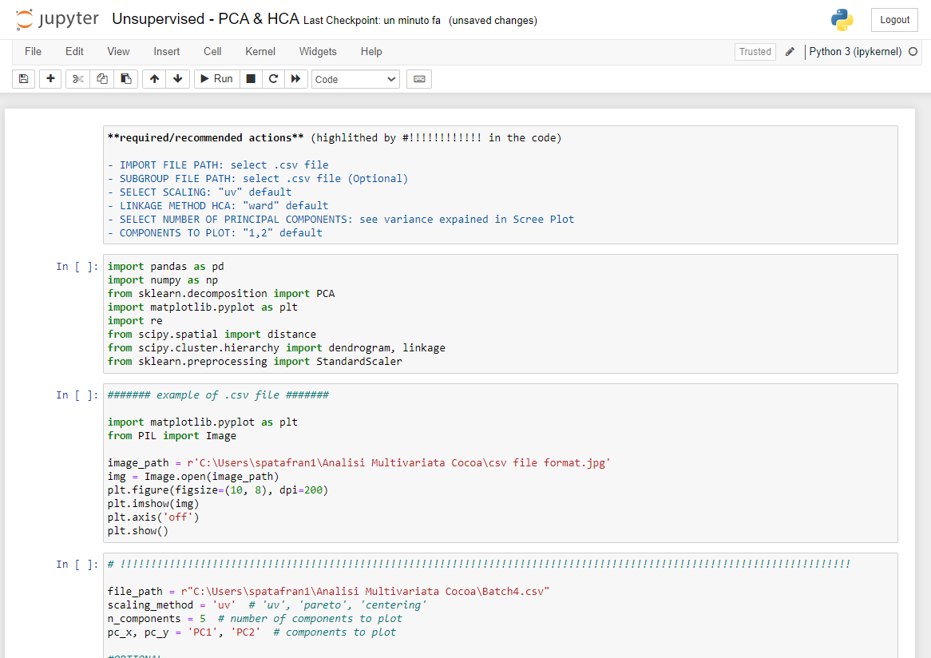
PYTHON
How a script appears:
Markdown = code explanation
External Libraries
Typically, in Python the flow is sequential
Cell = code block
May 2024 - Developed by F. Spataro (francesco.spataro@unipr.it)

Slide 9
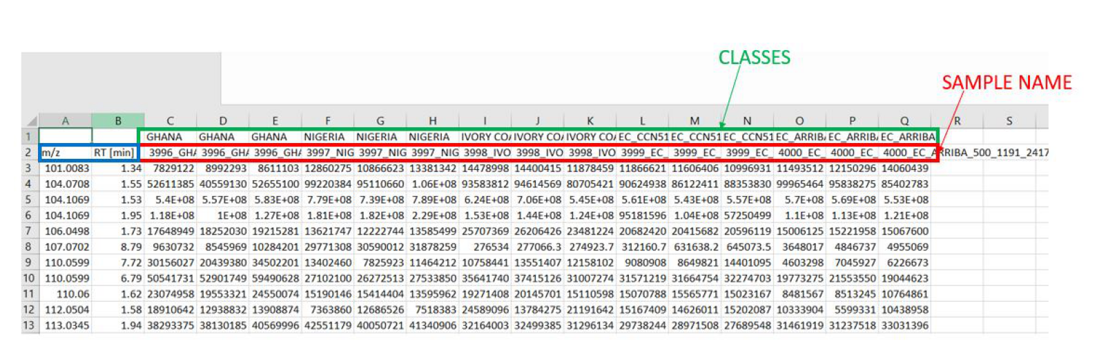
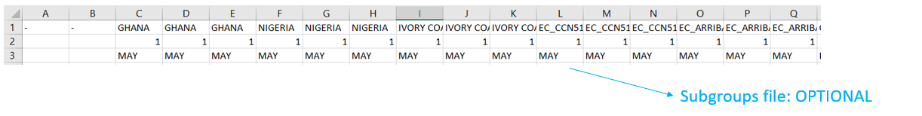
TIPS
MULTIVARIATE ANALYSIS TOOLS
To avoid occasionally encountering errors when loading data, it is advisable to save the .CSV in UTF-8 format.
- IMPORT FILE: .csv
X
Y
…for regression
to add new labels on graphs
May 2024 - Developed by F. Spataro (francesco.spataro@unipr.it)

Slide 10
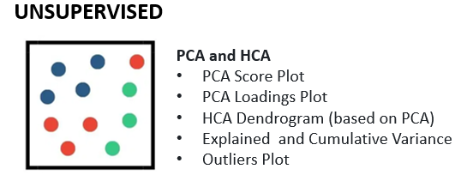
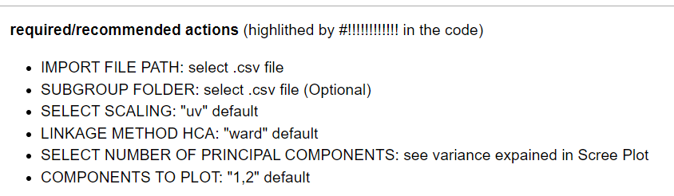
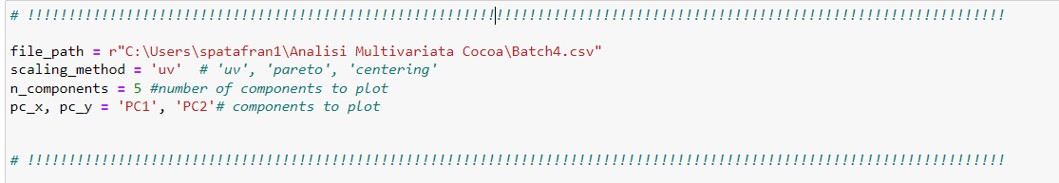
MULTIVARIATE ANALYSIS TOOLS
SCRIPT 1: Unsupervised - PCA & HCA
The tools are built to reduce "manual operations" to a minimum
Simple functions are needed...
then you can RUN the script and get RESULTS in seconds
TIPS: The scripts are totally editable, but for "user-friendly" use is enough to set a few parameters when "#!!!!!!!!!!!!!!!!!" is present in the code
May 2024 - Developed by F. Spataro (francesco.spataro@unipr.it)

Slide 11
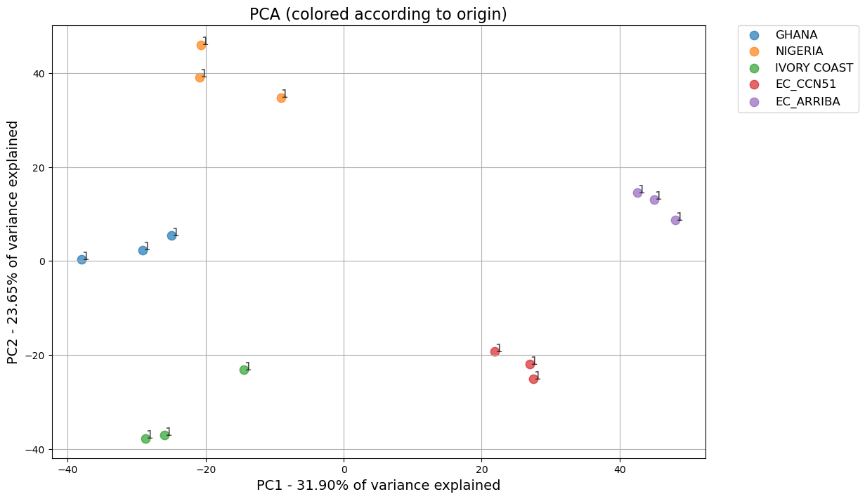
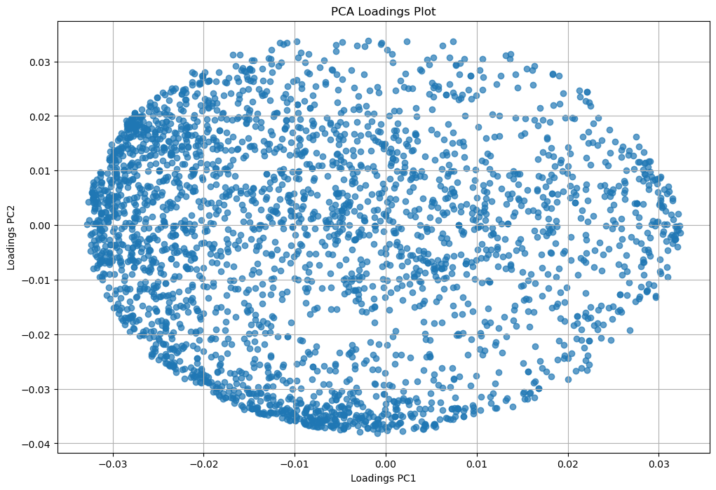
Report example for Cocoa
MULTIVARIATE ANALYSIS TOOLS
SCRIPT 1: Unsupervised - PCA & HCA
PCA – Score Plot
Loadings Plot
add labels on the observations
edit font-size
all colors are set following Matplotlib rules (Tab10 palette)
fixed bug present in SIMCA
Print loading values table for each component
May 2024 - Developed by F. Spataro (francesco.spataro@unipr.it)

Slide 12
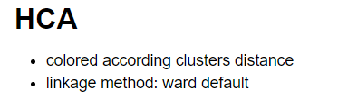


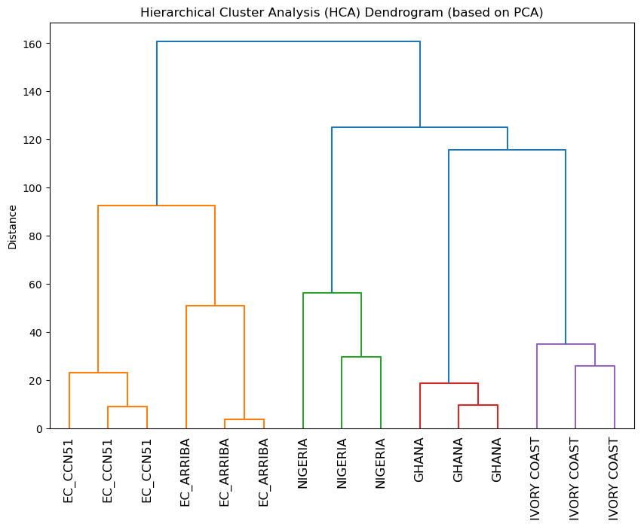
MULTIVARIATE ANALYSIS TOOLS
SCRIPT 1: Unsupervised - PCA & HCA
HCA - Dendrogram
Theory
calculation of distance between observations and coloration according to cluster distance
= only “ward” and “single”
May 2024 - Developed by F. Spataro (francesco.spataro@unipr.it)

Slide 13
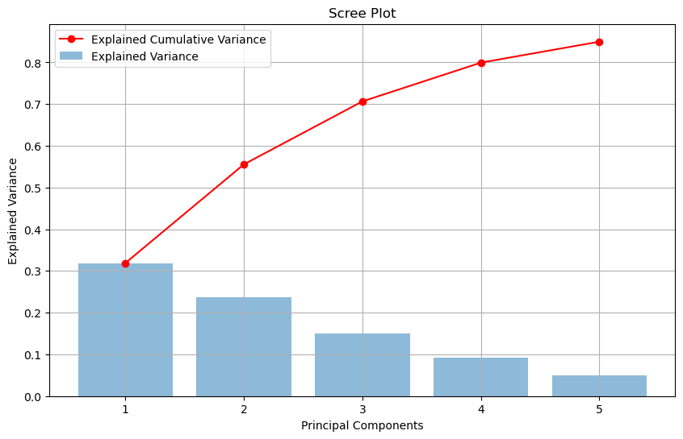
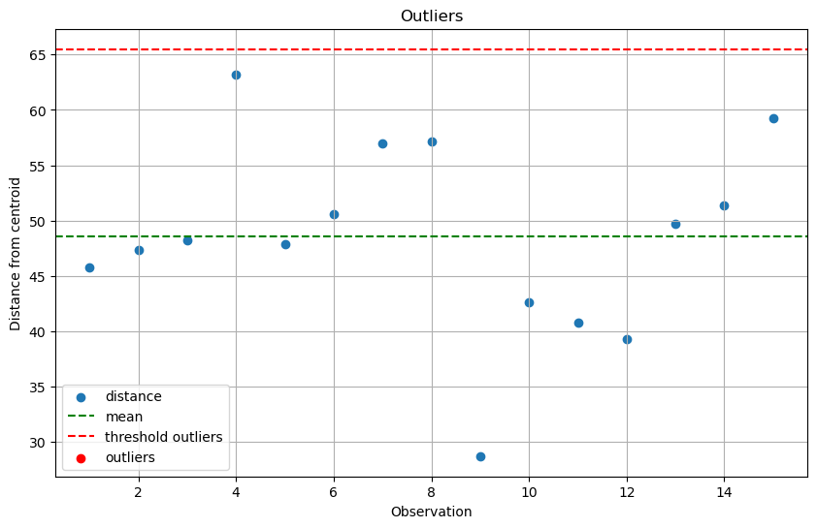
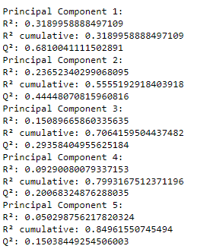
MULTIVARIATE ANALYSIS TOOLS
SCRIPT 1: Unsupervised - PCA & HCA
Scree Plot: Explained and Cumulative Variance
Outliers Plot
Theory
Centroid calculation
Euclidean distance of each observation
mean distance and deviation.
Threshold definition
Coefficients
(R², Q²)
May 2024 - Developed by F. Spataro (francesco.spataro@unipr.it)

Slide 14
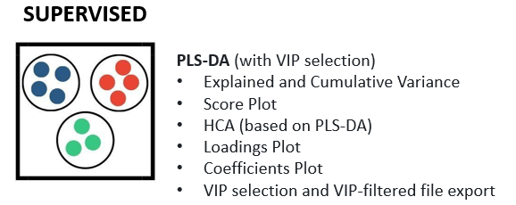
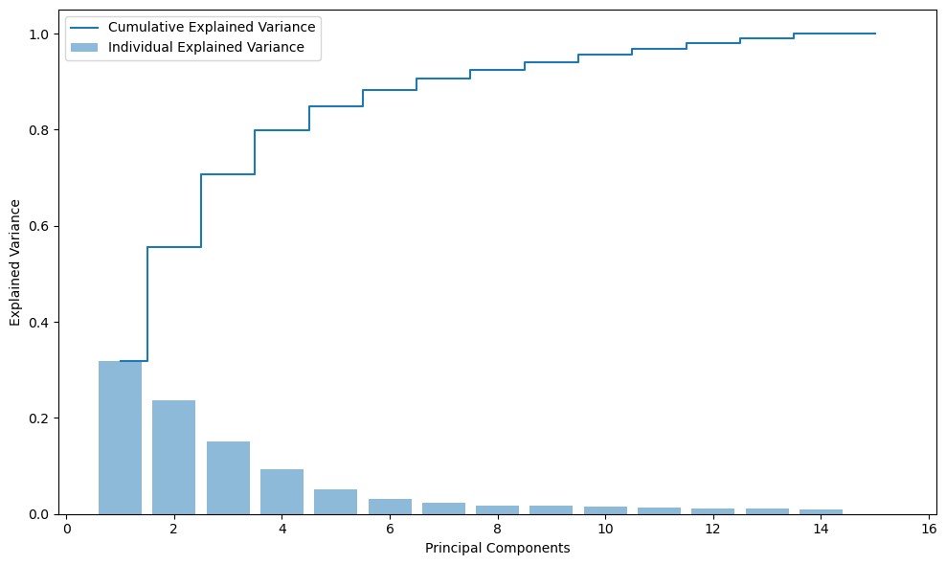
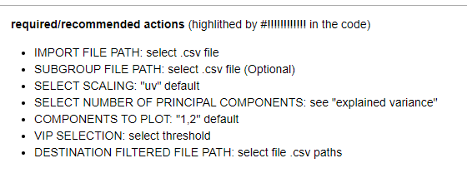
MULTIVARIATE ANALYSIS TOOLS
SCRIPT 2: Supervised – PLS-DA
Explained Variance
May 2024 - Developed by F. Spataro (francesco.spataro@unipr.it)

Slide 15
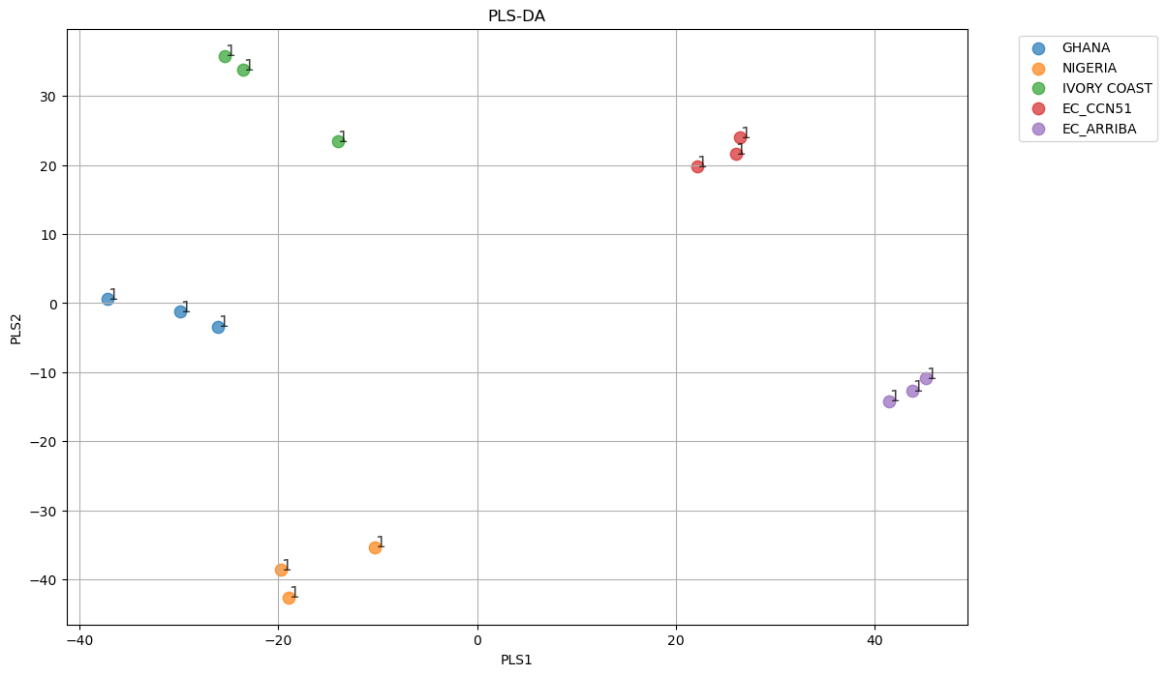
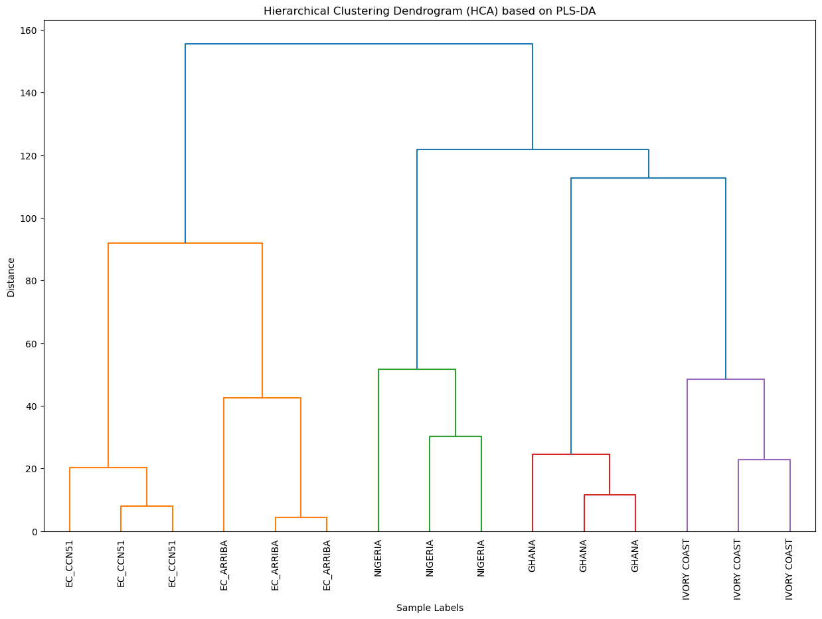
MULTIVARIATE ANALYSIS TOOLS
SCRIPT 2: Supervised – PLS-DA
PLS-DA Score Plot
HCA – Dendrogram (based on PLS-DA)
May 2024 - Developed by F. Spataro (francesco.spataro@unipr.it)

Slide 16
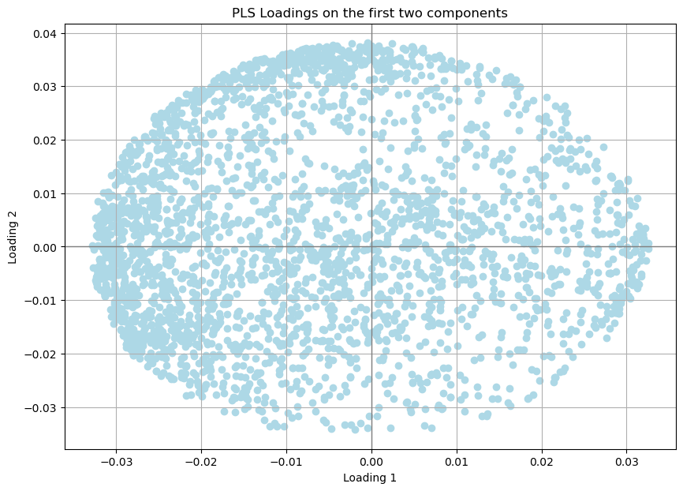
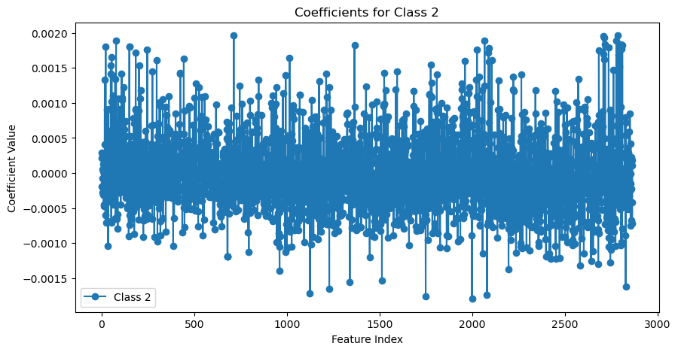
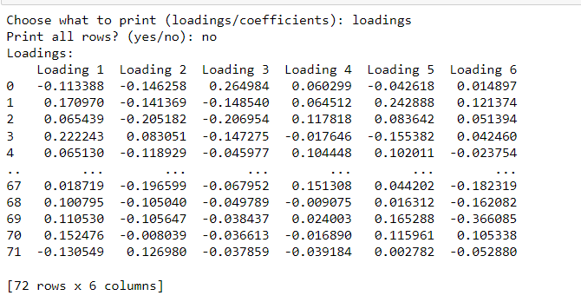
MULTIVARIATE ANALYSIS TOOLS
SCRIPT 2: Supervised – PLS-DA
Loadings
Coefficients
Ghana
Theory
For each class, variable coefficients describe the most important variables for that class. This could be an important alternative to VIP when you want to identify specific class variables.".
Print loading and coefficient values table for each component/class
May 2024 - Developed by F. Spataro (francesco.spataro@unipr.it)

Slide 17
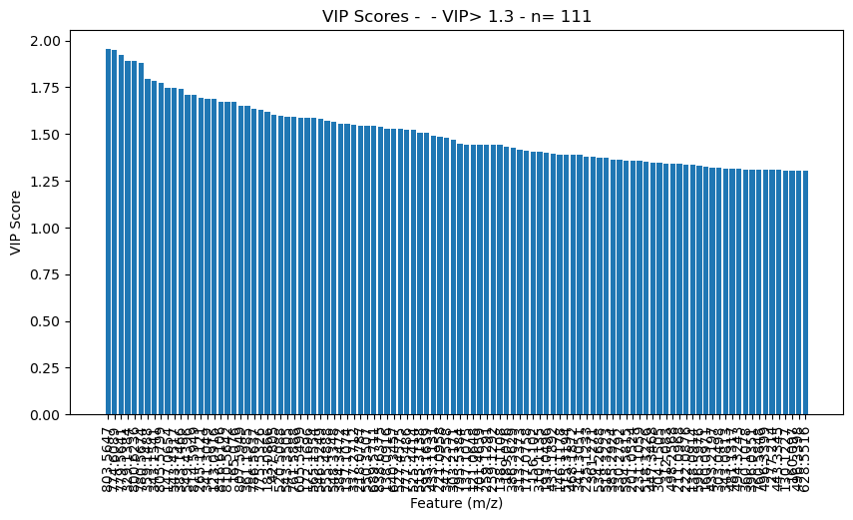
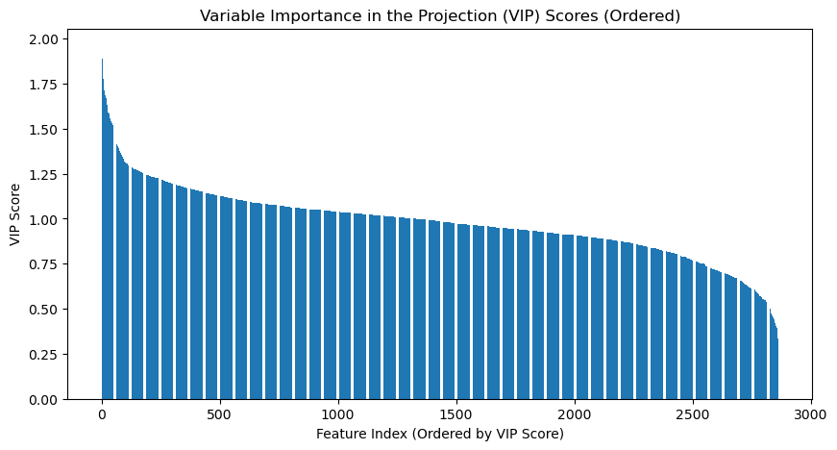
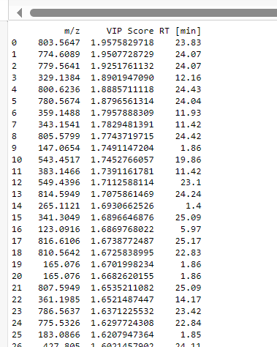
MULTIVARIATE ANALYSIS TOOLS
SCRIPT 2: Supervised – PLS-DA
VIPs selection
VIPs selection: >1.3
Export VIPs Table and new .csv file containing only filtered VIP observations
March 2024 - F. Spataro (francesco.spataro@unipr.it)

Slide 18
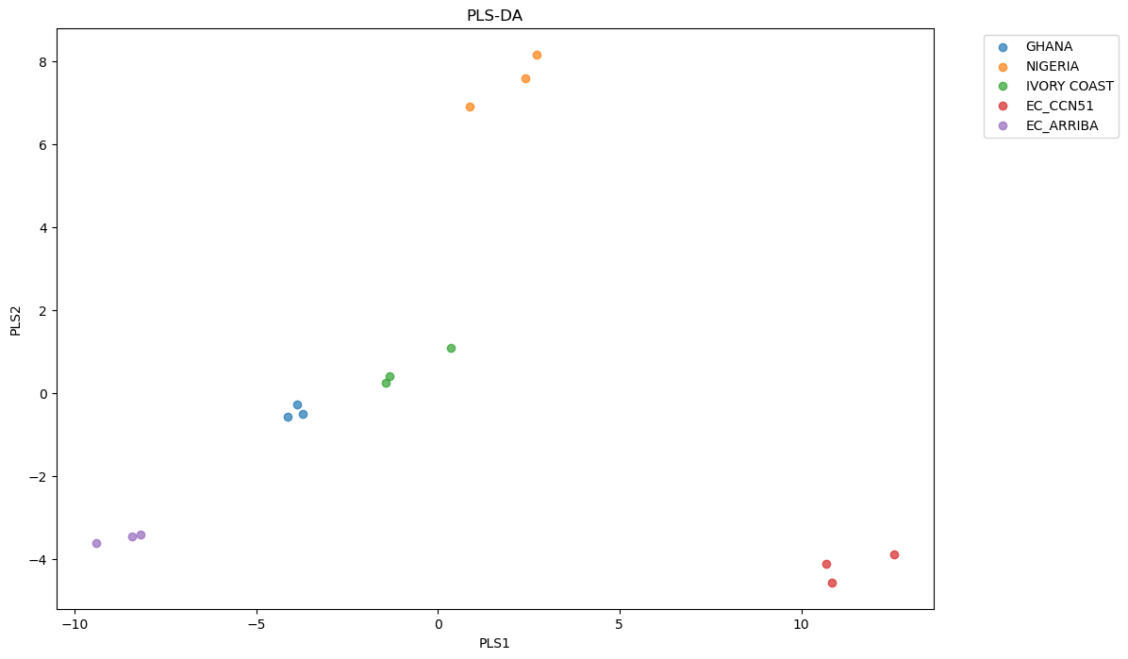
MULTIVARIATE ANALYSIS TOOLS
SCRIPT 2: Supervised – PLS-DA
Filtered VIPs: new PLS-DA model
May 2024 - Developed by F. Spataro (francesco.spataro@unipr.it)

Slide 19
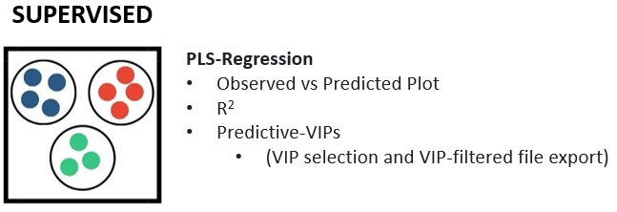
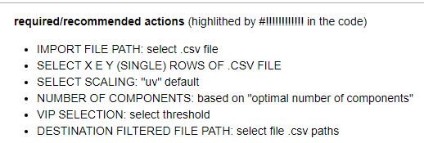
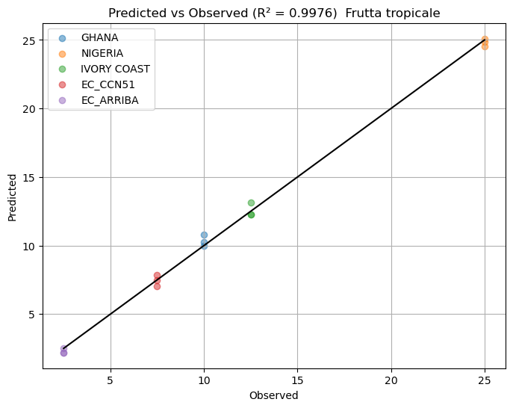
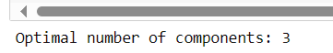
MULTIVARIATE ANALYSIS TOOLS
SCRIPT 3: PLS-Regression
Theory
Based on Mean Squared Error:
measure of the mean squared differences between observed ​​and predicted values
May 2024 - Developed by F. Spataro (francesco.spataro@unipr.it)

Slide 20
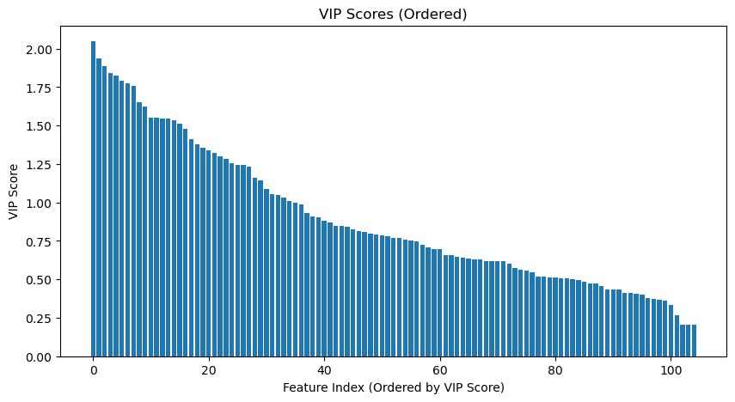
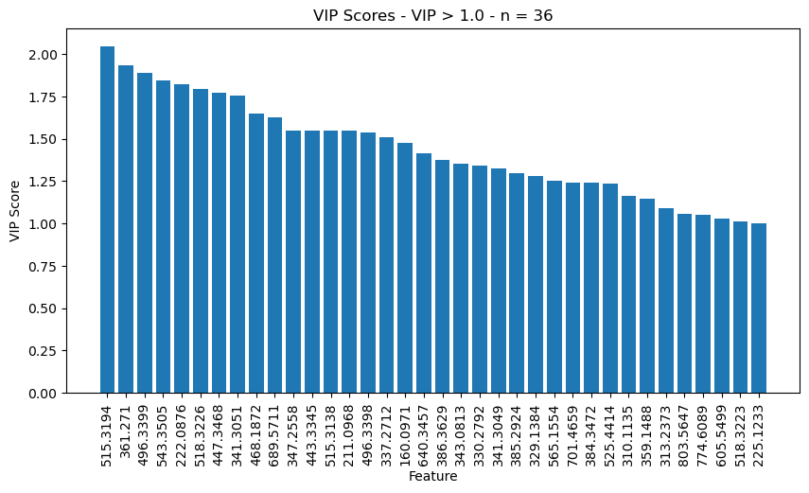
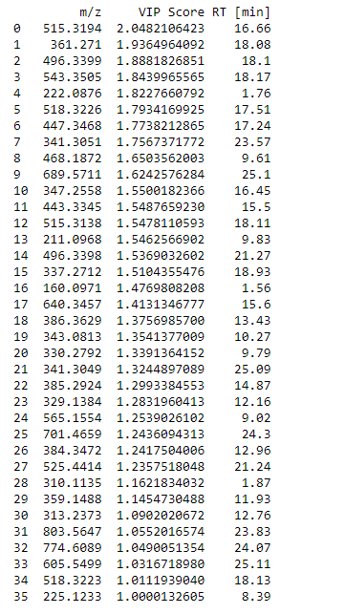
MULTIVARIATE ANALYSIS TOOLS
SCRIPT 3: PLS-Regression
Export VIPs Table and new .csv file containing only filtered VIP observations
May 2024 - Developed by F. Spataro (francesco.spataro@unipr.it)

Slide 21
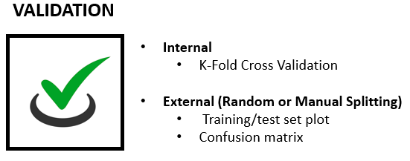
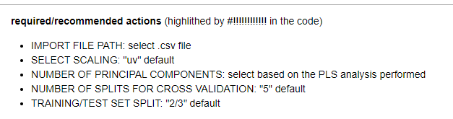
MULTIVARIATE ANALYSIS TOOLS
SCRIPT 4: Validation – Internal and External Validation (Random Splitting)
Theory
Internal Validation (model performance: K-Fold CV)
K-Fold Cross-Validation: a model evaluation technique that splits (usually default 5 or 10) the dataset into 𝑘 parts, using each part in turn as a test set and calculating the mean performance to estimate the model's accuracy.
On SIMCA cross-validation-ANOVA calculation
May 2024 - Developed by F. Spataro (francesco.spataro@unipr.it)

Slide 22
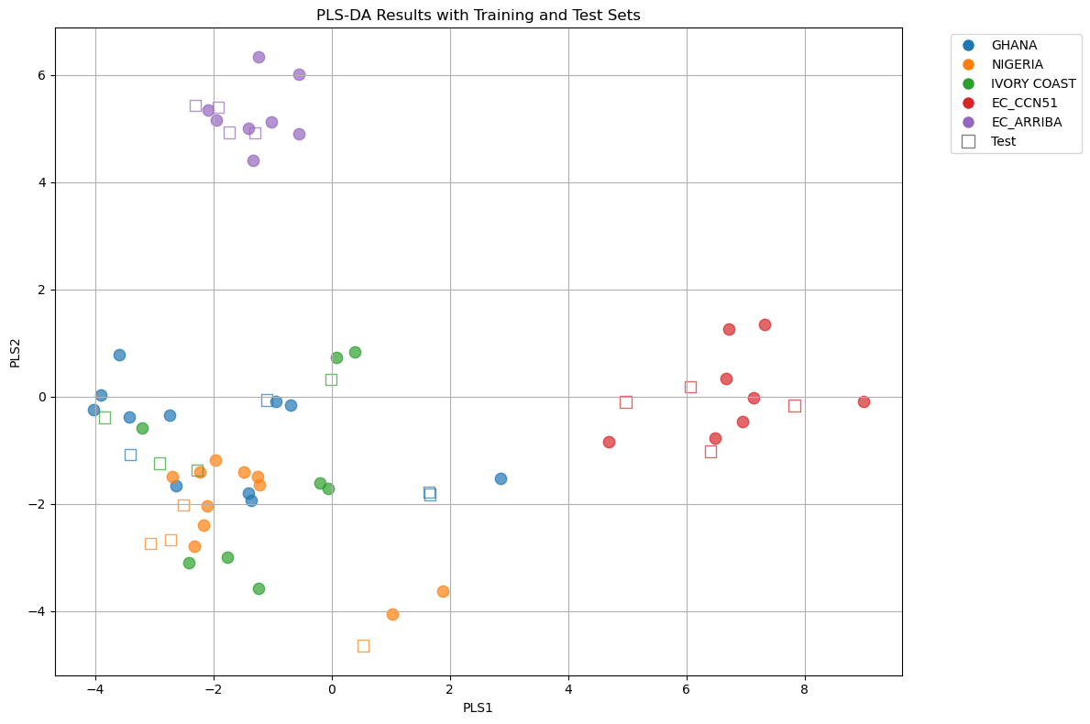

MULTIVARIATE ANALYSIS TOOLS
SCRIPT 4: Validation – Internal and External Validation (Random Splitting)
Select “split” type: es. 2/3
Random_state=42
=42, is just a widely used convention (you can use any number). For a given dataset, the randomization will always occur the same way. If you change the 'random seed' to any other number, you will get different results.
Training-Test Set PLS-DA Plot
"The Answer to the Great Question... Of Life, the Universe and Everything... Is... 42."
May 2024 - Developed by F. Spataro (francesco.spataro@unipr.it)

Slide 23
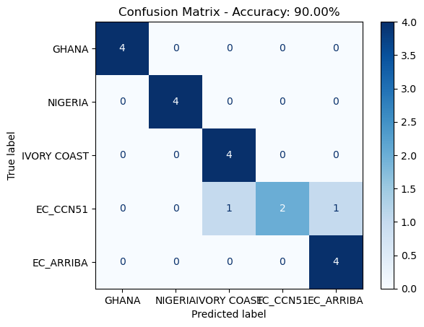
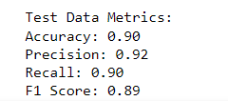
MULTIVARIATE ANALYSIS TOOLS
SCRIPT 4: Validation – Internal and External Validation (Random Splitting)
On SIMCA a “missclassification” is performed
Confusion Matrix
Theory
Accuracy, Precision, Recall or F1? | by Koo Ping Shung | Towards Data Science
May 2024 - Developed by F. Spataro (francesco.spataro@unipr.it)

Slide 24
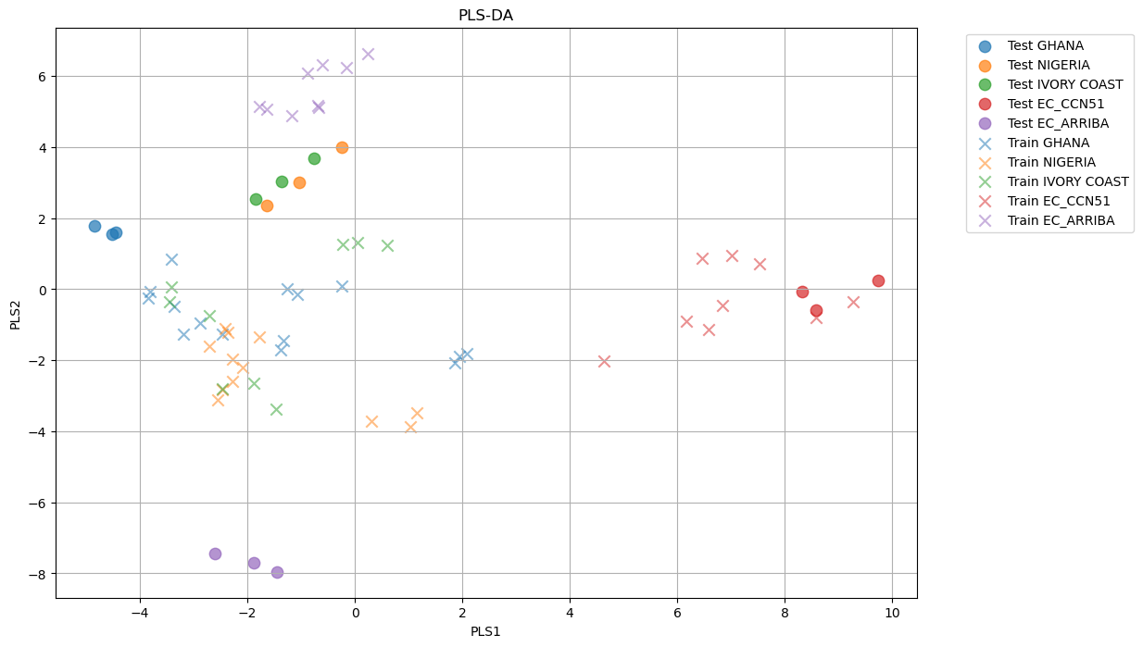
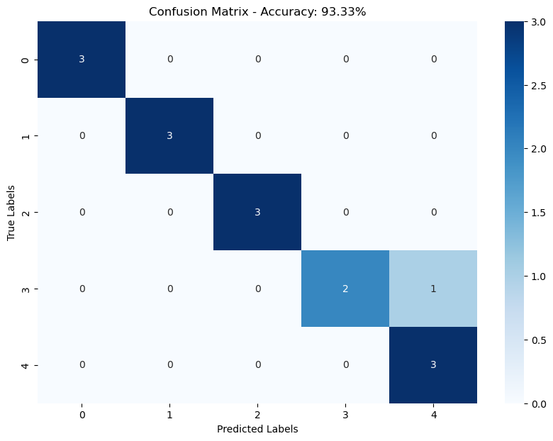
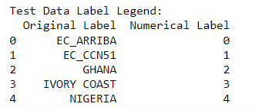
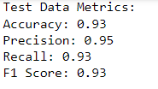
MULTIVARIATE ANALYSIS TOOLS
SCRIPT 5: Validation – External Validation (Manual Splitting)
Training-Test Set PLS-DA Plot
Confusion Matrix
Es. Batch 4 test set
May 2024 - Developed by F. Spataro (francesco.spataro@unipr.it)

Slide 25
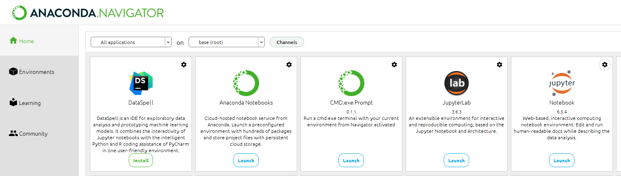

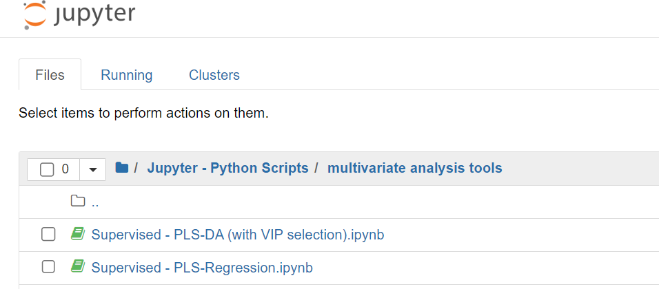
TIPS
TOOLS AND REPOSITORIES ACCESS
What is required? (for FERRERO system PC)
Due to problems with the proxy, the computer could not access files on the desktop, I recommend using the user folder:
e.g. C:\Users\spatafran1
1.
Download Now | Anaconda
2.
Code download:
GitHub repositories
(Registration is required)
Data Analysis (Developed Tools) (github.com)
Send me an email, I will send you the invitation link: francesco.spataro@guest.ferrero.com
3.
4.
Open code on Jupyter
May 2024 - Developed by F. Spataro (francesco.spataro@unipr.it)

Slide 26


TOOLS AND REPOSITORIES ACCESS
GitHub allows us to create a repository where we can update and download different codes accessible to all, as well as directly exchange information on bugs, features and requests
May 2024 - Developed by F. Spataro (francesco.spataro@unipr.it)

